Slide 2
Introduction to Database
What is a database? A database is a collection of structured data. A database captures an abstract representation of the domain of an application.
Typically organized as “records” (traditionally, large numbers, on disk) and relationships between records
This class is about database management systems (DBMS): systems for creating, manipulating, accessing a database.
A DBMS is a (usually complex) piece of software that sits in front of a collection of data, and mediates applications accesses to the data, guaranteeing many properties about the data and the accesses.

Slide 3



What is database management system ?
App1
App2
DBMS
DB
DBMS
DB
"a system to create,
"a collection of structure data"
APP1
manipulate, access databases
(
mediate access to the data)"
APP2
Figure 1: What is a database management system?
Ubiquity (anywhere from your smartphone to Wikipedia)
Real roughly world $20B/y). impact: Websites, software big mark companies both day to day operations as well as business intelligence + data mining. • You need to know about databases if you want to be happy!
Th

Slide 4
Need of Database
Ubiquity (anywhere from your smartphone to Wikipedia)
Real world impact: Websites, software market, big companies, scientific projects all manage both day to day operations as well as business intelligence + data mining.
The goal of a DBMS is to simplify the storing and accessing of data. To this purpose DBMSs provide facilities that serve the most common operations performed on data. The database community has devoted significant effort in formalizing few key concepts that most applications exploit to manipulate data. This provides a formal ground for us to discuss the application requirements on data storage and access, and compare ways for the DBMS to meet such requirements.

Slide 5
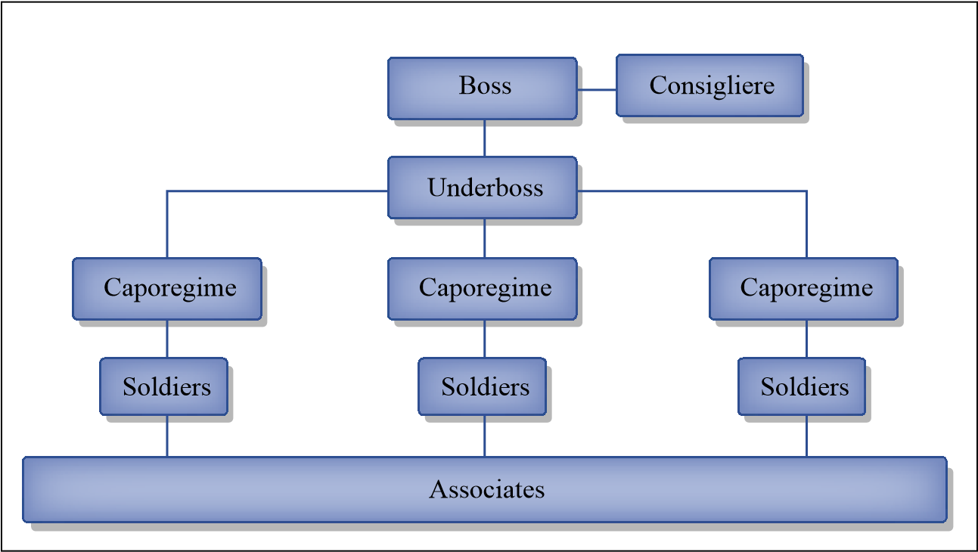
CASE STUDY-MAFIA EXAMPLE
Let us assume I am a Mafia Boss hypothetically!, and I want to organize my group of “gang” ( criminals/bad guys working for the boss, a.k.a the soldiers,) to achieve more efficiency in all our operations. I will also need a lot of book-keeping, security/privacy etc.. Note that my organization is very large, so there is quite a bit of things going on at any moment (i.e., many people accessing the database to record or read information).
Image by MIT Open Courseware.
Figure 2: Mafia hierarchy.

Slide 6
Mafia Example(Contd-)
I need to store information about:
people that work for me (soldiers, caporegime, etc..)
organizations I do business with (police, politicians)
completed and open operations:
protection rackets ,arms trafficking ,drug trafficking loan sharking, control of contracting/politics
I need to avoid that any of my man is involved in burglary, mugging, kidnapping (too much police attention)
cover-up operations/businesses
money laundring and funds tracking
• assignment of soldiers to operations etc.

Slide 7
Mafia Example(Contd-)
I will need to share some of this information with external organizations I work with, protecting some of the information. Therefore, I need:
the boss, an underboss and consigliere should be able to access all the data and perform any kind of operations such as (assign soldier to operations, create or shutdown operations, pay cops, check the total state of money movements, etc.)
the accountants( 20 of them) access to perform money bookkeeping ( track money laundering operations, move money from bank to bank , report bribing expenses)
the soldiers (5000) need to report daily misdeeds in a daily-log, and report money expenses and collections.
the semi public interface accessible by other bosses I collaborate with

Slide 8





Mafia Example(Contd-)
name
name
nickname
involve
operation
desc
person
$$
phone
coverup-name
log_id
collaboration_with
log
author
title
summary
accounts
organization
boss
rank
account-number
false-identity
balance
What data to store in Mafia database

Slide 9
TASK
You are hired to create my Mafia Information System, if you get it right you will have satisfaction and a great life. If you get it wrong... well you don’t want to get it wrong

Slide 10
YOU HAVE TO THINK ON FOLLOWING QUESTIONS
What to represent ?
How to store data:
Control access credentials at low granularity :
How to access data :
Access patterns and performance :
Atomicity :
Consistency :
Isolation:
Durability:

Slide 11
Limitation of File System
If you select File system for the above case, it fails so solution is DATBASE SYSTEM.
1-3 (DATA MODEL)
4-5 (QUERY LANGUGAE)
6-9 (TRANSACTIONS)

Slide 12
FUNDAMENTAL CONCEPTS OF DATABASE SYSTEM
Representation of Data : We need a consistent structured way to represent data, this is important for consistency, sharing, efficiency of access. From database theory we have the right concepts.
Data Models : a set of constructs (or a paradigm) to describe the organization of data. For example, tables (or more precisely relations), but we could also choose graph, hierarchies, objects, triples <subject, predicate, object>,etc.
Conceptual/Logical Schema: is a description of a particular collection of data, using the given data model (e.g., the schema of our Mafia database).
Physical Schema: is the physical organization of the data (e.g., data and index files on disk for our Mafia database).
2. Query Processing :-a high-level (typically declarative) language to describe operations on data (e.g., queries, updates). The goal is to guarantee Data independence (logical and physical), by separating “what” you want to do with data from “how” to achieve that (more later).
High level language for accessing data
“Data Independence” (logical and physical)
Optimization Techniques for e accessing data
3. Transactions: - a way to group actions that must happen atomically (all or nothing)
guarantees to move the DB content from a consistent state to another
isolate from parallel execution of other actions/transactions
recoverable in case of failure (e.g., power goes out)

Slide 13
Solution to MAFIA CASE with DATABASE approach
Choose a level of abstraction and describe only the relevant details. For instance,
each person has real name, nickname, phone number
each operation has a name, description, economical value, cover-up name
info about the persons involved in an operation and their role,
We could represent this data according to many different data models:
Hierarchies
Objects
Graph
Triples
Tables etc..
Different data models are more suited for different problems.

Slide 14
Solution to MAFIA CASE with DATABASE approach
Let’s choose the relational data model and represent this problem using “tables”.
Again, there are many ways to structure the representation, i.e., different “conceptual/logical schemas” that could capture the reality are modeling. For example, we can have a single big table with all info together... again, is redundant and might slow down all the access to data.
The “database design” is the art of capturing a set of real world , concepts and their relations in the best possible organization in a database.
involved
pers
_
name
oper_name
rols
person
carlo
snowflake
chief
operation
name
nickname
phone
tony
snowflake
sold
title
descr.
econ_val
coverup
carlo
baffo
123
mike
chocolate
chief
snowflake
..
$10M
laundromat
mike
lungo
456
chocolate
...
$5M
irish pub
tony
shifezza
789
caffe
...
$2M
irish pub
Simple logical schema for MAFIA database

Slide 15
Accessing the Data
The key idea is that you describe “what” you want to access, rather than “how” to access it.
Eg.
Which operations involve” Chota Rajan”
Select oper-name from involved where person =“Chota Rajan”
Now every different access to the data, i.e., every “query” should become different program opening the files, scanning them, reading or writing certain fields, saving the files.

